Slide 1

MINI PROJECT ON CERTIFICATE GENERATION SYSTEM Submitted By:- Bhushan Pradhan - 46 Ameya Joshi -20 Anyket Khandekar-23 Aditya Mohite -34 MENTOR :- Prof. Ranjita Gaonkar DEPARTMENT OF COMPUTER ENGINEERING PILLAI COLLEGE OF ENGINEERING NEW PANVEL – 410 206 UNIVERSITY OF MUMBAI Academic Year 2019-20

Slide 2
PROBLEM STATEMENT
The certificate generation system should be able to generate certificates for events held in PCE such as Alegria, PBL, CSI workshop etc. The application should be developed using Java as front end and MYSQL/ POSTGRESQL as backend. Develop different templets for different certificates. The application should generate ready to print certificate.

Slide 3
PLATFORMS USED
Frontend: Netbeans ide.
Backend : mySQL.

Slide 4

NETBEANS
NETBEANS PLATFORM
The NetBeans Platform is a framework for simplifying the development of java swing desktop applications.
NETBEANS IDE
NetBeans IDE is an open source integrated development environment. NetBeans IDE supports development of all Java application types (JAVA SE (including javaFX), java me, web and mobile applications) out of the box.

Slide 5

MySQL is an open-source relational database management system (RDBMS).Its name is a combination of "My", the name of co-founder Michael Widenius's daughter, and "SQL", the abbreviation for Structured Query Language.
OTHER DATABASES:
ADABAS.
IBM DB2
Microsoft Access
Microsoft Excel
Microsoft SQL Server

Slide 6
GUI(Graphical User Interface)
The graphical user interface is a form of user interface that allows users to interact with electronic devices through graphical icons and visual indicators such as secondary notation, instead of text-based user interfaces, typed command labels or text navigation.

Slide 7
COMPONENTS OF GUI
Buttons
Table, Panel, Frame
Textfields
Panels and Containers
Password Fields

Slide 8
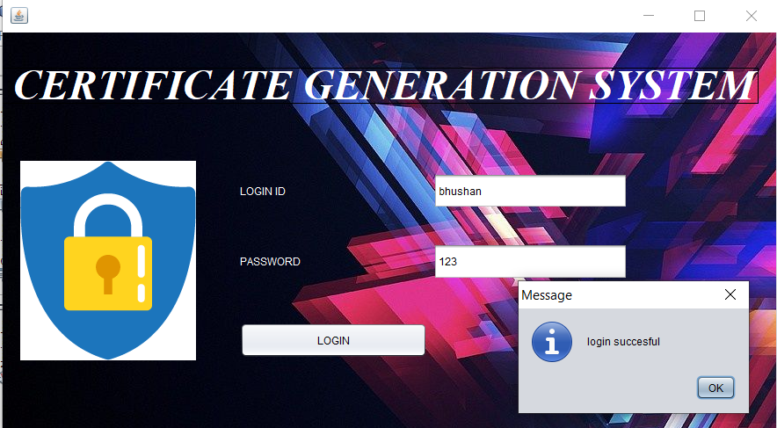
CERTIFICATE GENERATION SYSTEM
LOGIN PAGE:
User has to type a login id and password and click login.
This executes search query of mysql and fetch data.
If data is not found user has to sign up.

Slide 9
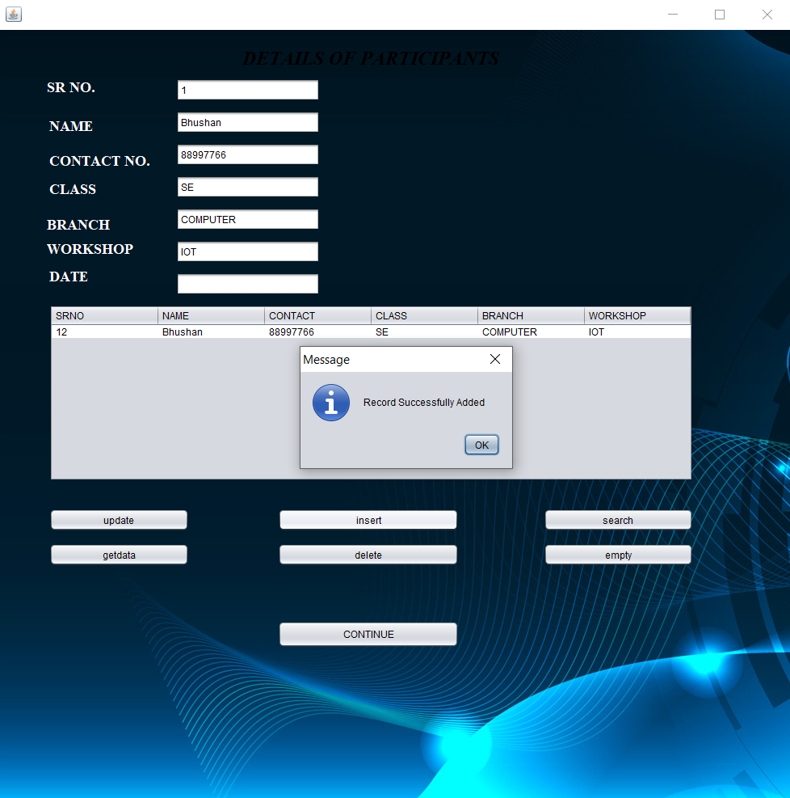
DETAILS OF PARTICIPANTS
Functions performed
Get data: to fetch data from MySQL.
Search: To search from MySQL.
Insert : To insert data.
Update: To update data.
Empty: To empty the table.
Delete: To delete all contents of table.

Slide 10
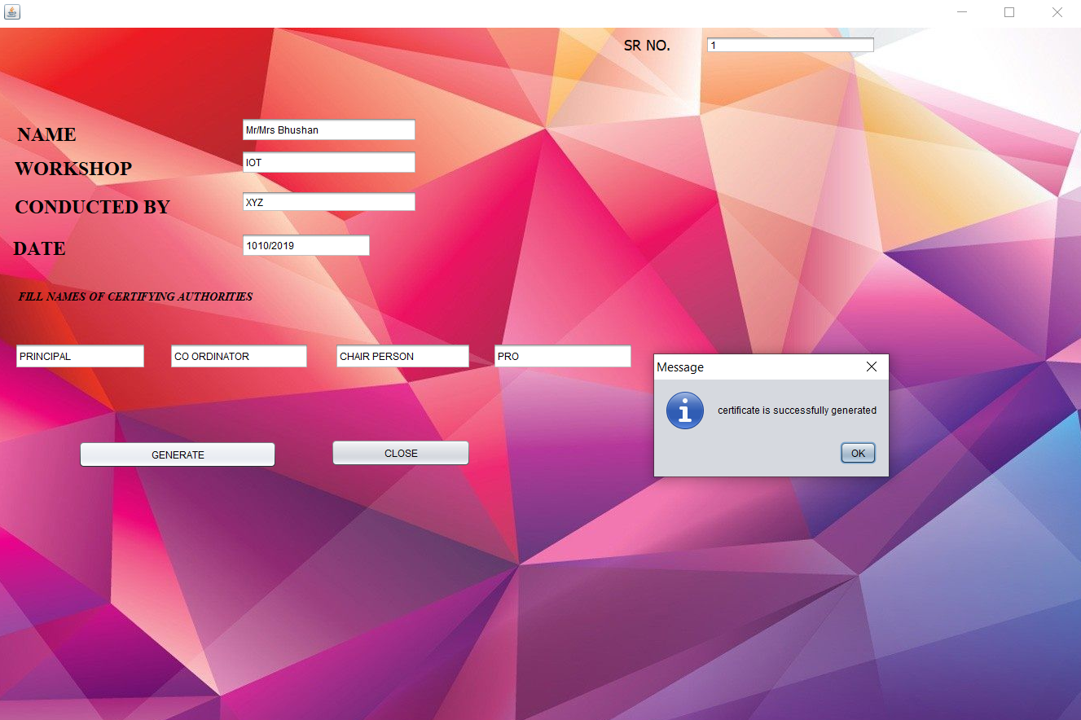
GENARATE CERTIFICATE
Necessary details of participants are fetched and names of the authorities should be mentioned in text fields.

Slide 11
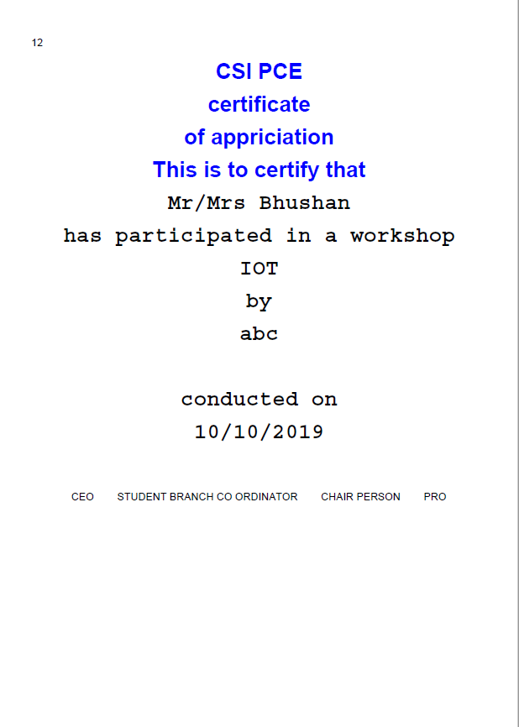
SAMPLE CERTIFICATE

Slide 12
Future scope
This project serves a basic idea for certificate generator. Since database is used, student data is safe and can be retrieved , modified and deleted at any point of time.
Further more templets can be designed which will have option for designing certificate for various purposes.
This application directly makes a pdf of the certificate so this can be sent as e certificate to participants or even can be printed.

Slide 13
ACKNOLEDGEMENT
We would like to express our special thanks of gratitude to Principal Dr. Sandeep Joshi, H.O.D. Dr. Sharvari Govilkar and Prof. Smita Joshi and Prof. Ranjita Gaonkar who gave us the opportunity to do this project based learning in the topic certificate generation system which helped us in applying the knowledge that we have acquired during the semester and learn new concepts. We are immensely grateful to all of them for sharing their pearls of wisdom with us during this course of project based learning.

Slide 14
THANK YOU

